Slide 1

Average Mortality Rates
A data analysis of the top 10 most populous countries and their average Adult mortality rates based on various societal factors

Slide 2
Contributors
Caleb Wolf
Kyle Burks
Chavell Scott
Simone de Oliveira Allen

Slide 3
What we set out to prove

Slide 4
Lessons Learned

Slide 5
10 most populous countries
China
India
United States
Indonesia
Brazil
Pakistan
Nigeria
Bangladesh
Russian Federation
Mexico

Slide 6
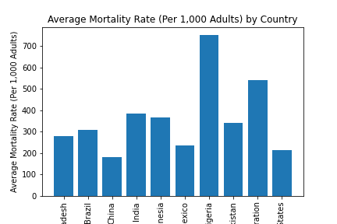
Average Mortality Rate By Country

Slide 7
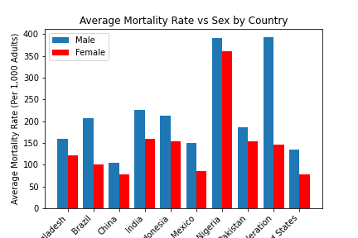
Average Mortality Rate By Sex in Each Country

Slide 8
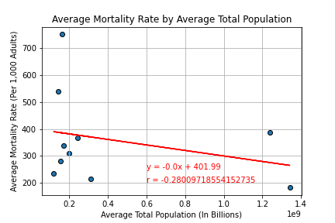
Average Mortality Rate By Country

Slide 9
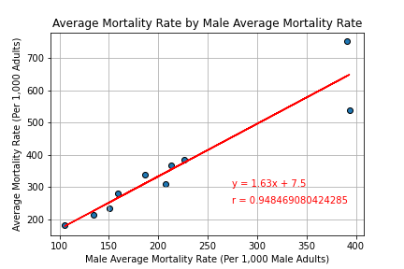
Male Average Mortality Rate

Slide 10
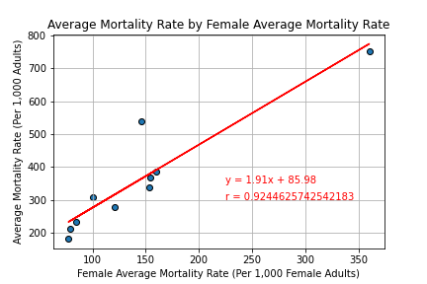
Female Average Mortality Rate

Slide 11
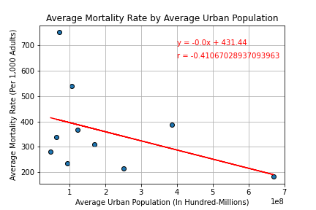
Average Mortality Rate By Urban Population

Slide 12
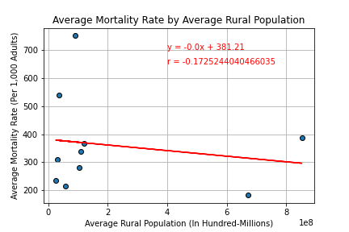
Average Mortality Rate By Rural Population

Slide 13
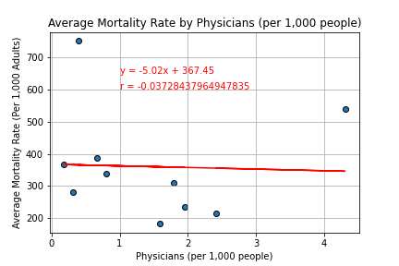
Average Mortality Rate By Physicians (per 1k people)

Slide 14
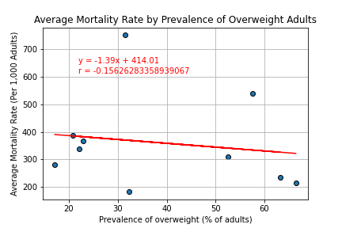
Average Mortality Rate By Overweight Adults

Slide 15
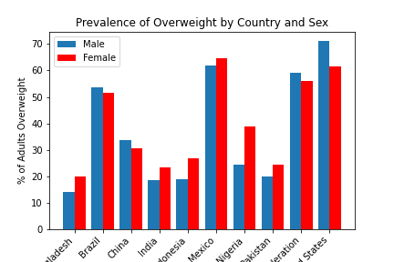
Prevalence of Overweight By Country and Sex

Slide 16
Final Analysis

